Slide 1
Project on Placement Management System
Group Members: Pinal Sonar
Sneha Gaikwad
Neha
Unnati Kamble
Kaveri Kapse
Group No: 05

Slide 2
Introduction
Manual Training and Placement which is done at various colleges is by human intervention due to which there is a maximum chance of errors. The major problem is searching and updating of the student data.
This is tedious and time consuming. Chances of missing data are also possible.
Placement Management System’ like many other placement management web sites, provides information on placement providers and the placements and also keeps up to date information of all students.

Slide 3
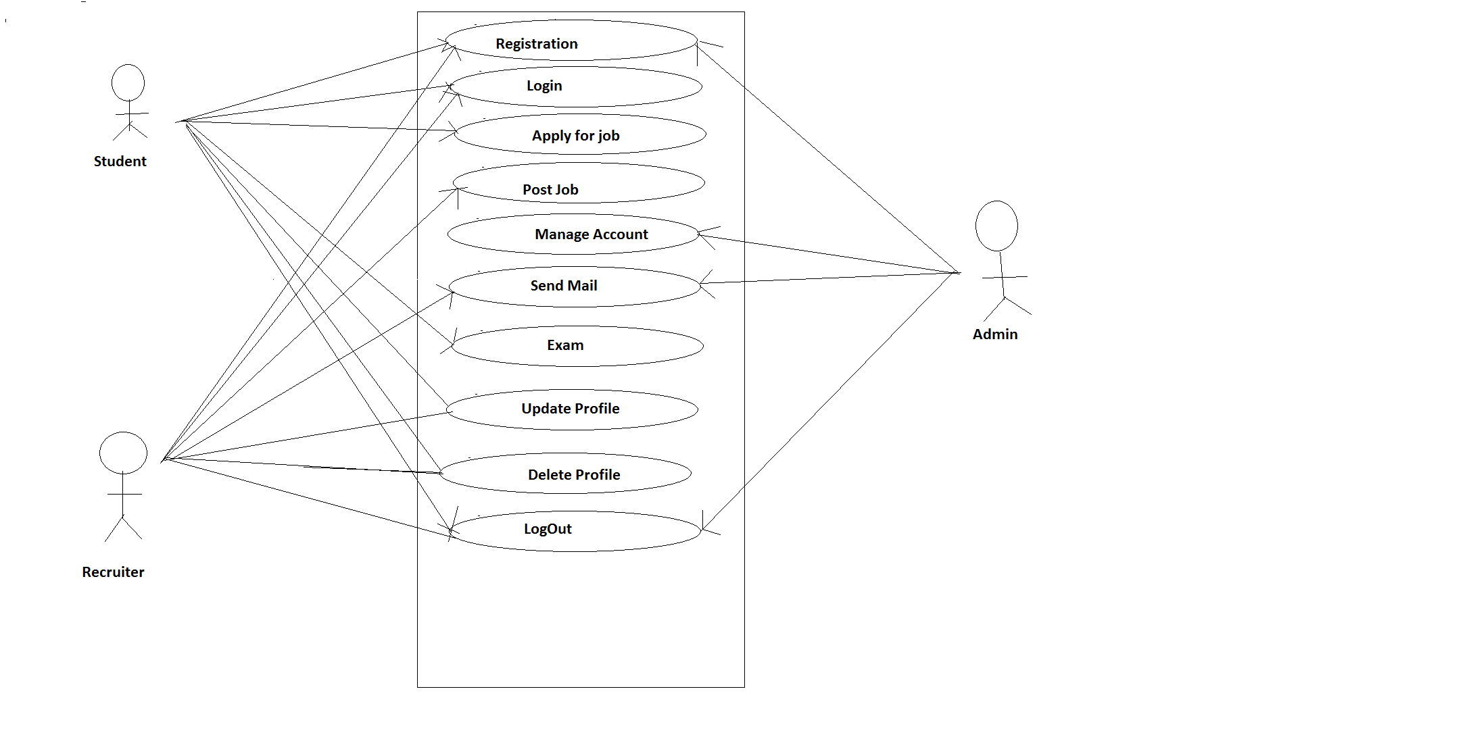
Use case Diagram
Fig. Use case Diagram for Placement Management System

Slide 4
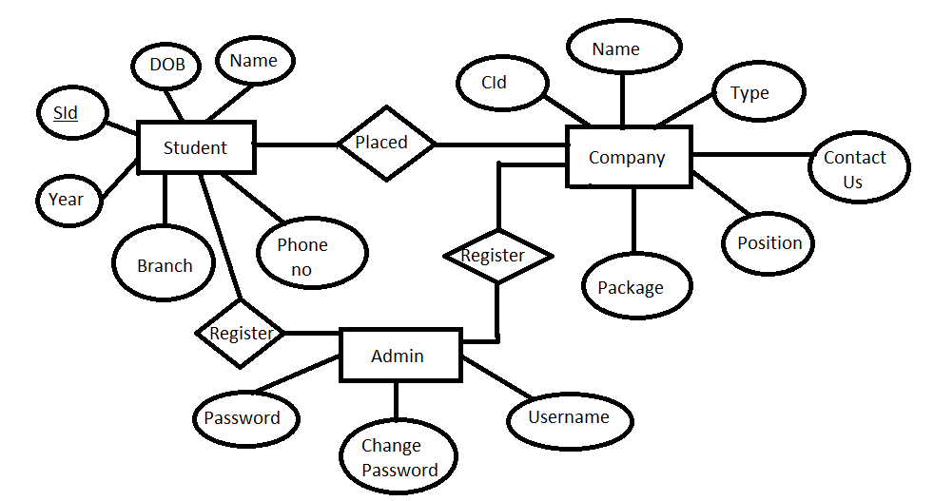
ER Diagram
Fig. ER diagram for Placement Management System

Slide 5
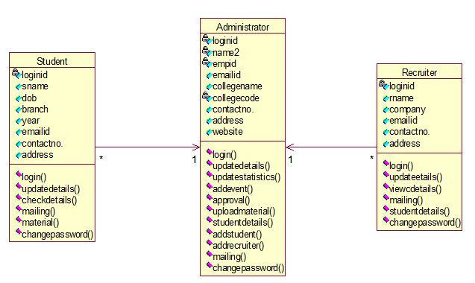
Class Diagram
Fig. Class Diagram for Placement Management System

Slide 6
Hardware & Software Requirements
Hardware Requirement: Processor Intel Dual Core
Operating System : Windows 7
Software Requirement:
MySQL: It is a relational Database Management System. As a database it is a software product whose primary function is to store and retrieve data as requested by another software application .

Slide 7
Introduction of Programming Environment
The project is developed in Core Java and MySQL.
Core Java provides following features for project:
Platform Independent
Object Oriented
Robust
Dynamic Binding
Good Performance

Slide 8
MySQL provides following Features:
Superior Speed
Ease of Use
Reliability

